Slide 1





INDIAN
PREMIER
LEAGUE
Presented by Jatin Kharbanda

Slide 2


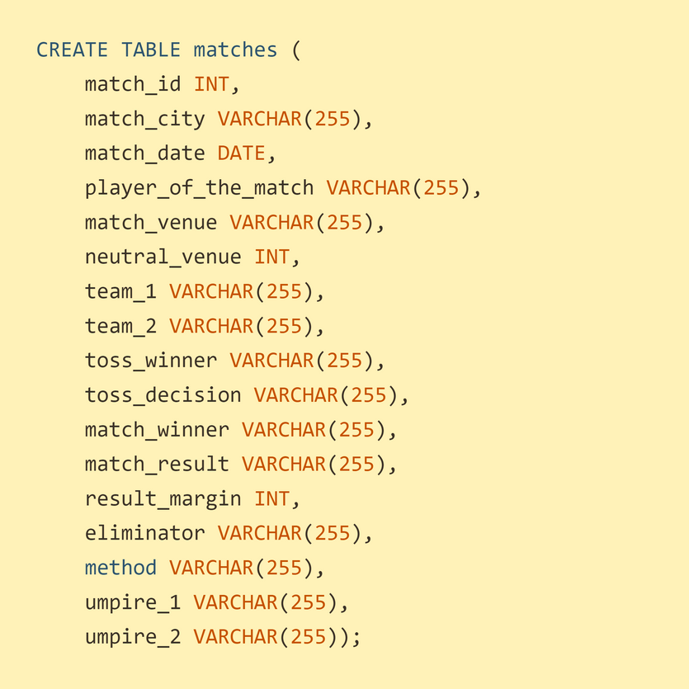
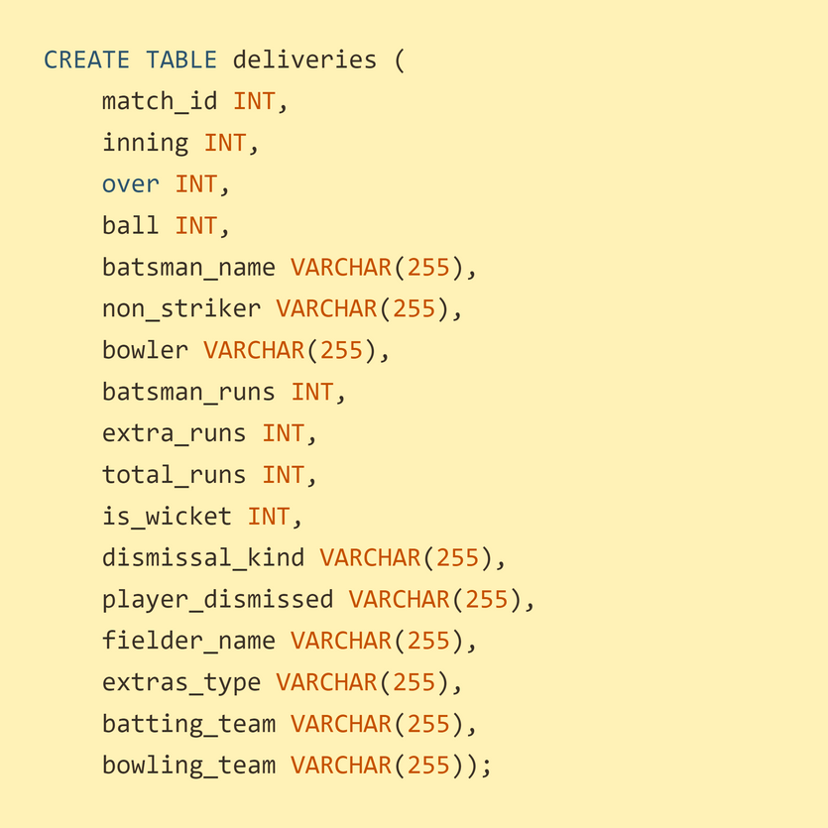


Creating TABLES
MATCHES
IPL Balls(Deliveries)

Slide 3

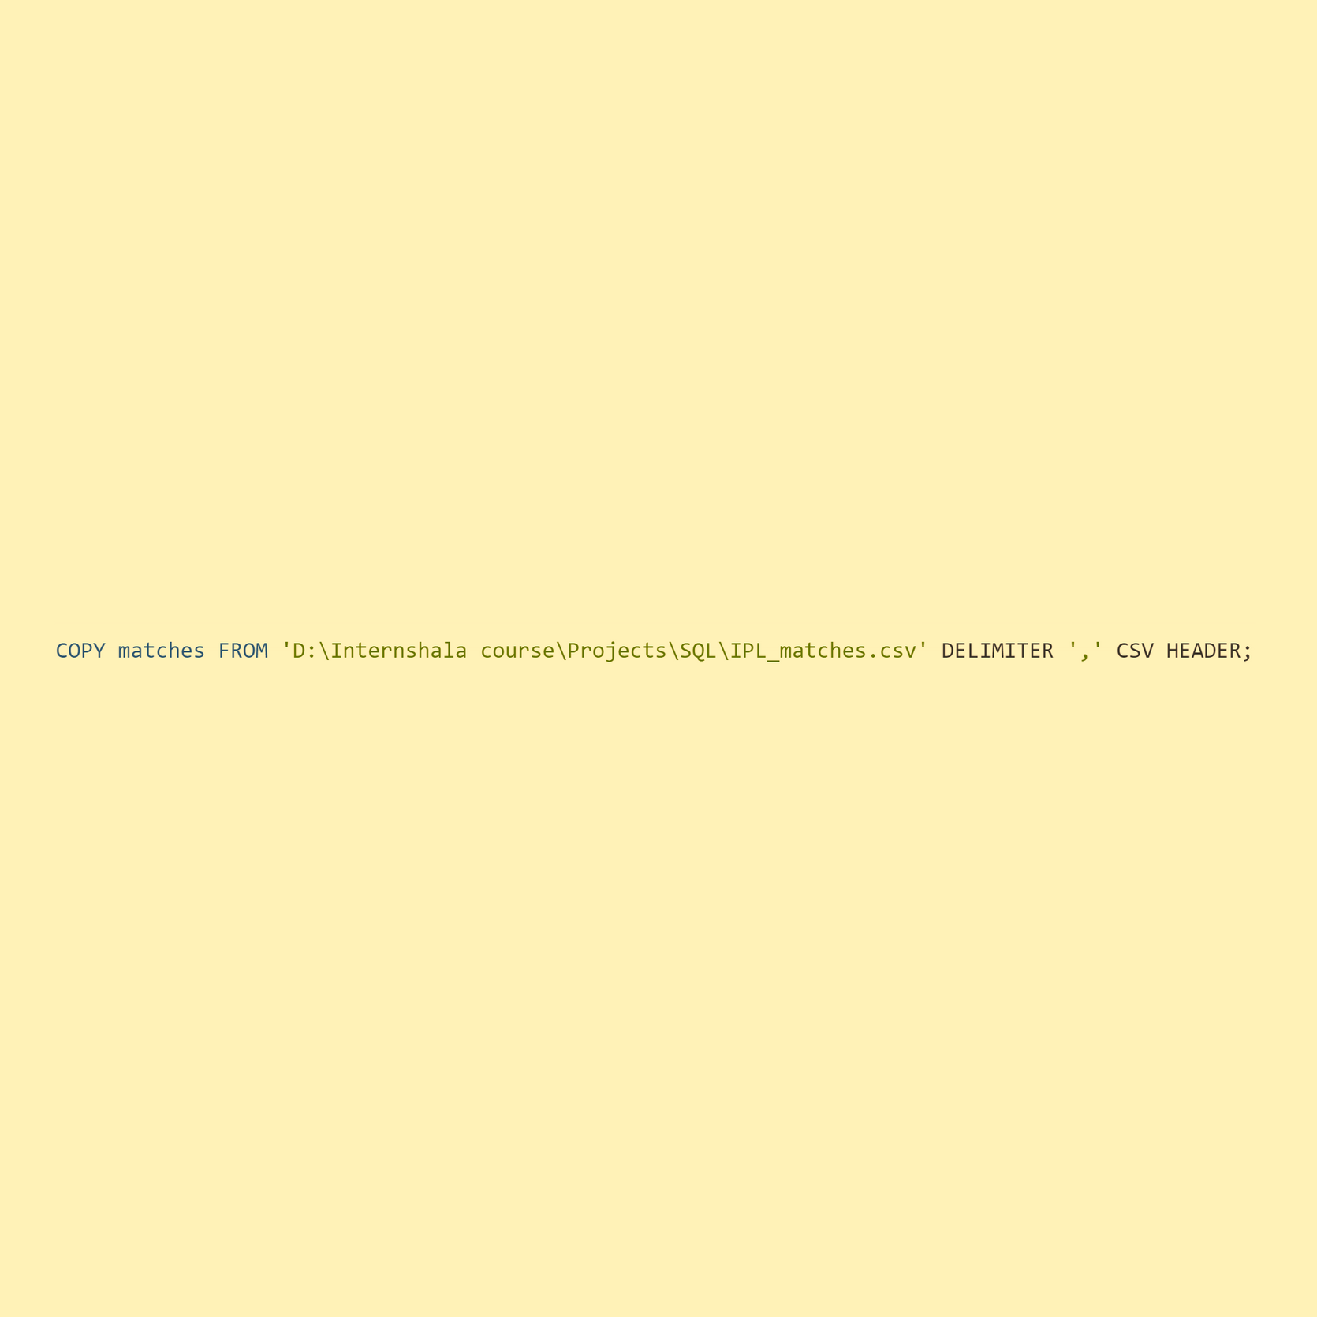

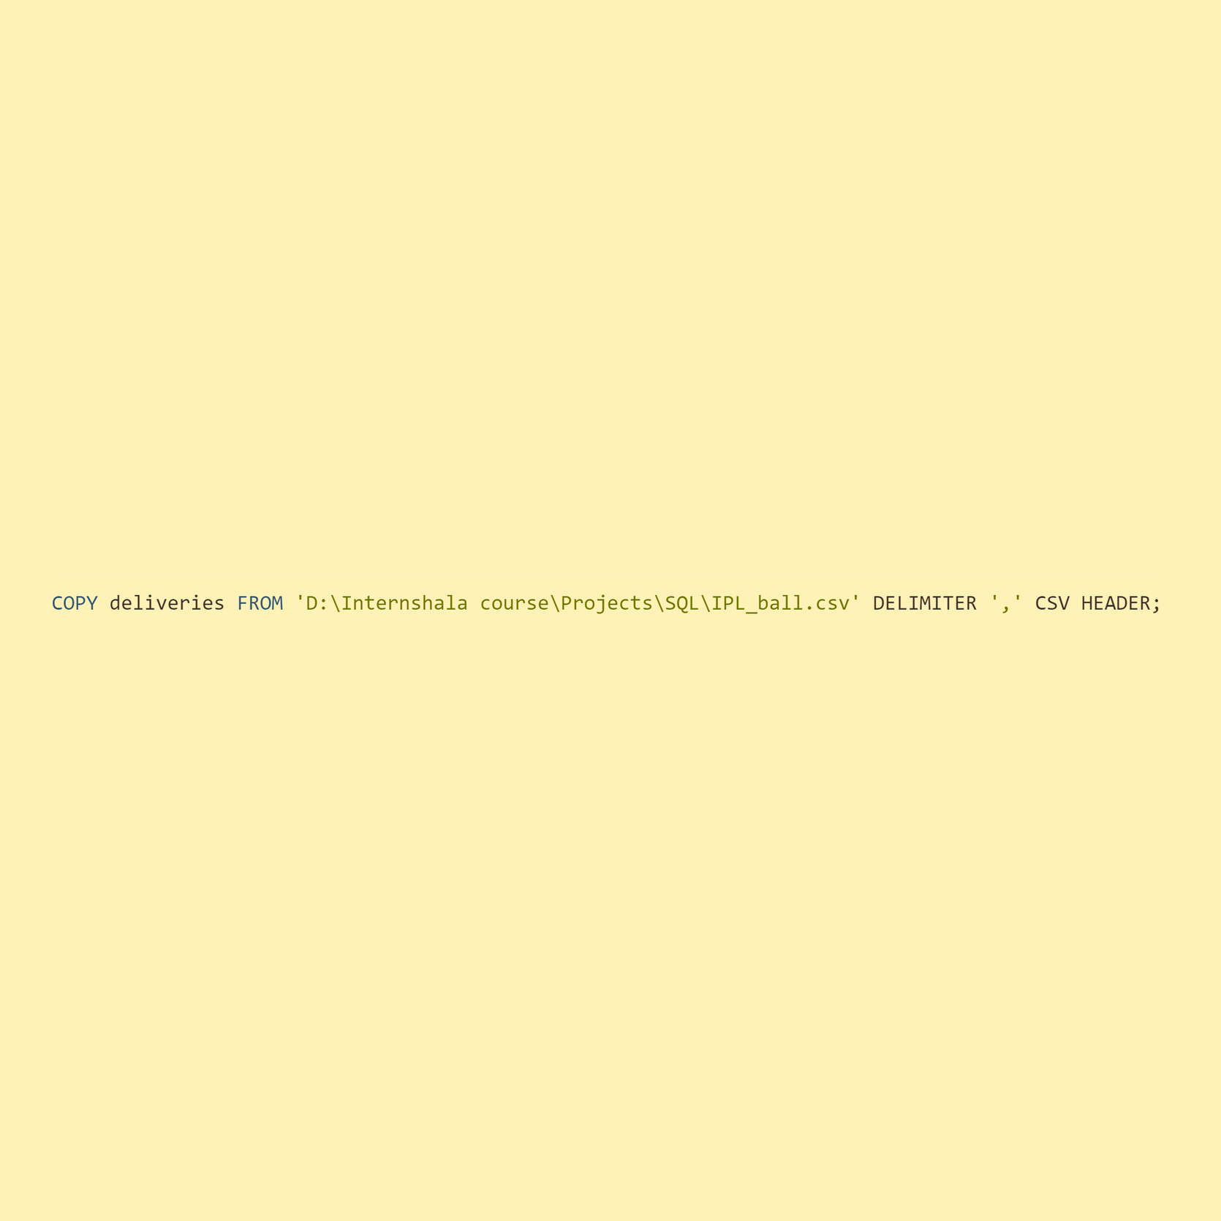
DATA COPY

Slide 4

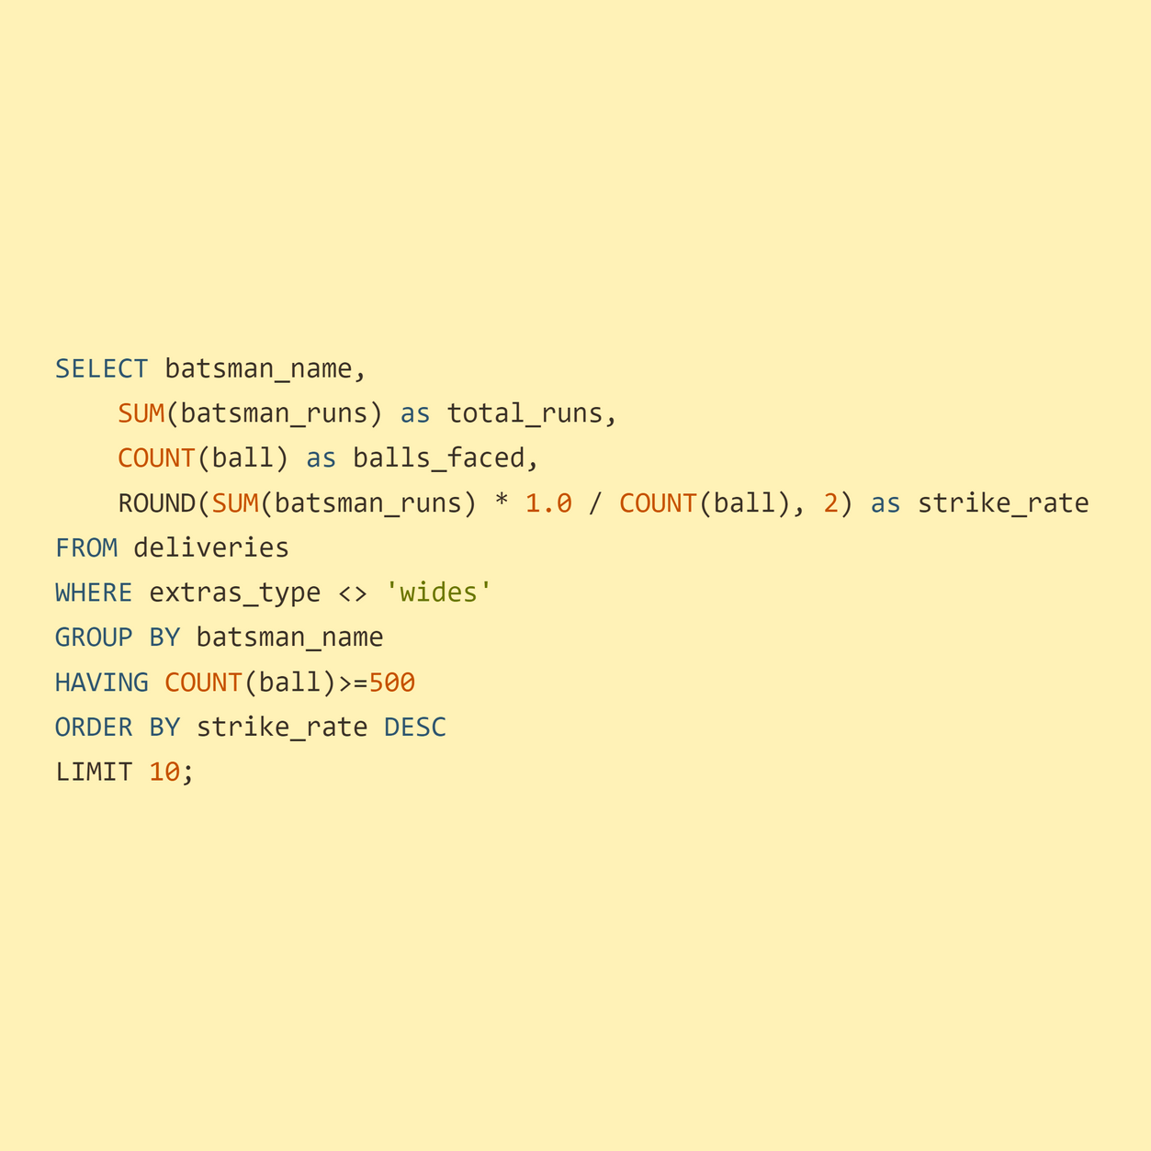


Batters Type 1
Strike Rate
Task
Query
Your first priority is to get 2-3 players with high S.R who have faced at least 500 balls.And to do that you have to make a list of 10 players you want to bid in the auction so that when you try to grab them in auction you should not pay the amount greater than you have in the purse for a particular player

Slide 5
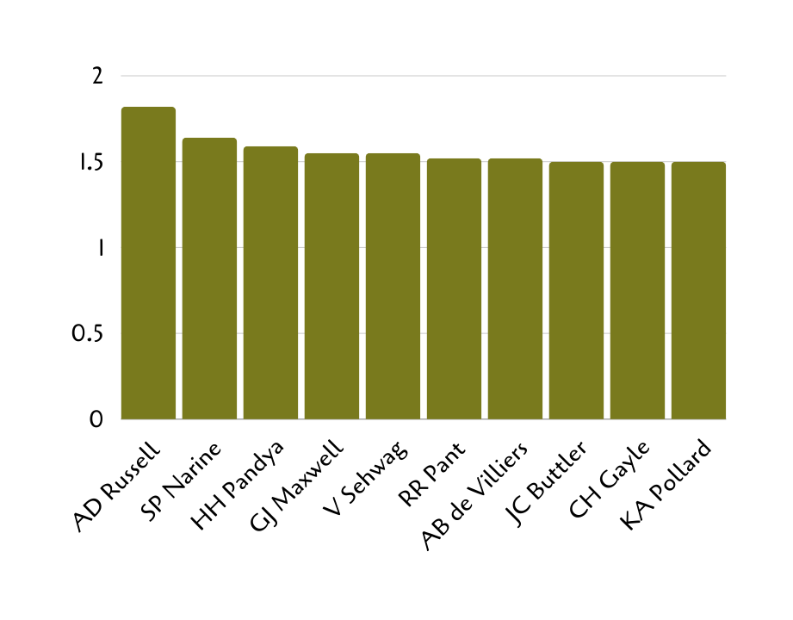
Batters Type 1
Strike Rate
Table
Batsman Runs | Total Runs | Balls Faced | Strike Rate
AD Russell | 1517 | 832 | 1.82
SP Narine | 892 | 543 | 1.64
HH Pandya | 1349 | 847 | 1.59
GJ Maxwell | 1505 | 973 | 1.55
V Sehwag | 2728 | 1755 | 1.55
RR Pant | 2079 | 1368 | 1.52
AB de Villiers | 4849 | 3192 | 1.52
JC Buttler | 1714 | 1146 | 1.50
CH Gayle | 4772 | 3179 | 1.50
KA Pollard | 3023 | 2017 | 1.50
Chart

Slide 6
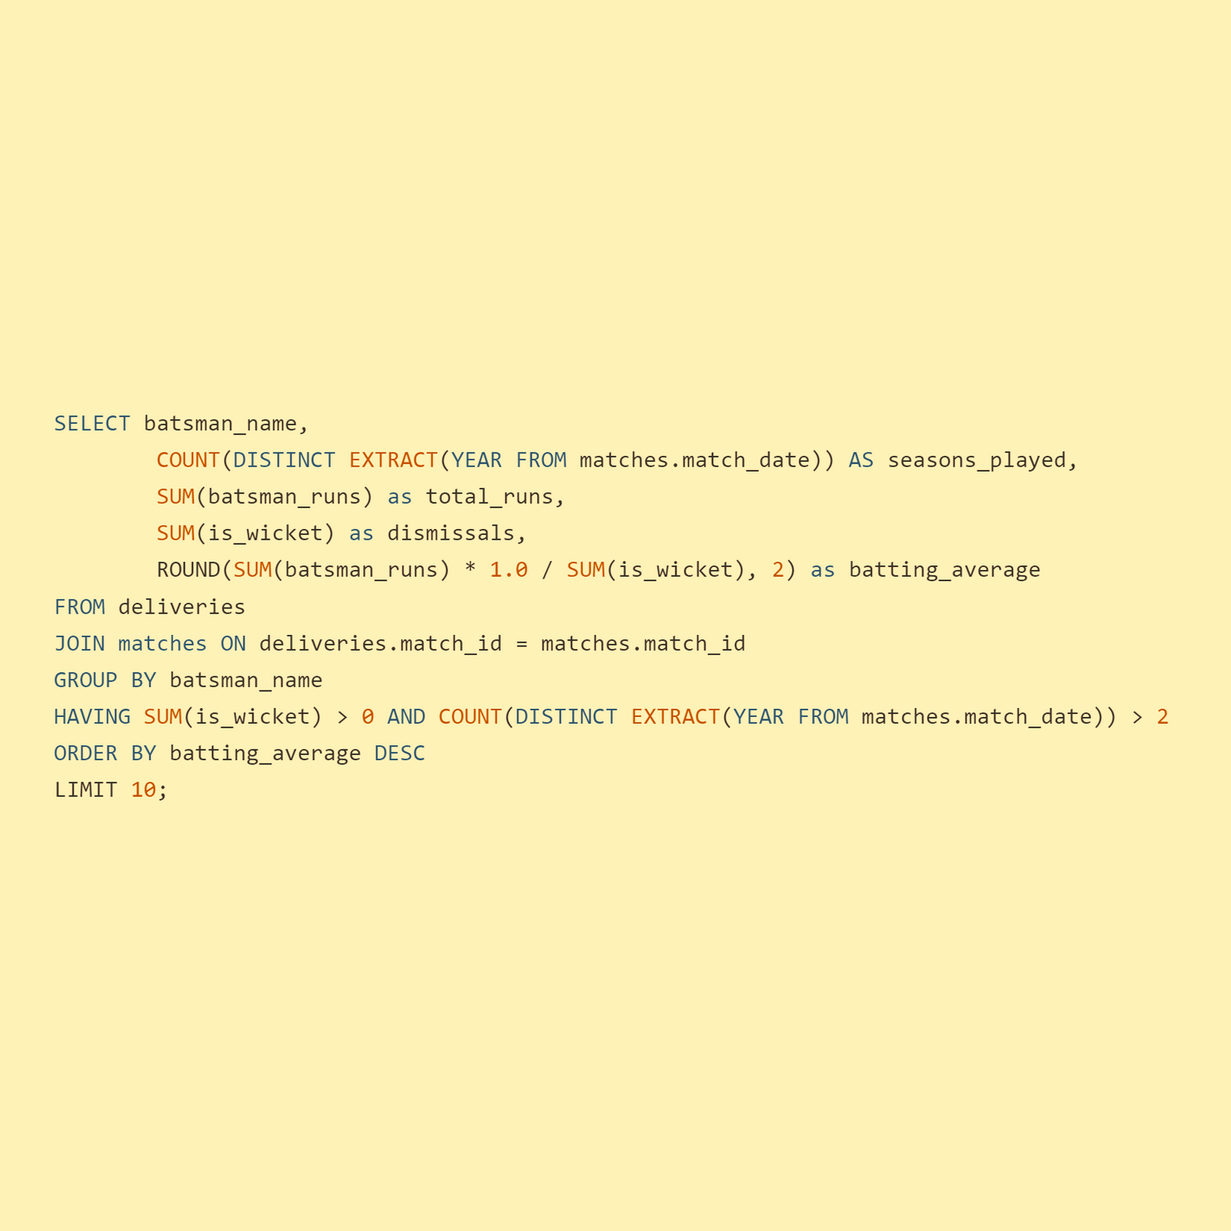
Batters Type 2
Good Average
Task
Query
Now you need to get 2-3 players with good Average who have played more than 2 ipl seasons. And to do that you have to make a list of 10 players you want to bid in the auction so that when you try to grab them in auction you should not pay the amount greater than you have in the purse for a particular player

Slide 7
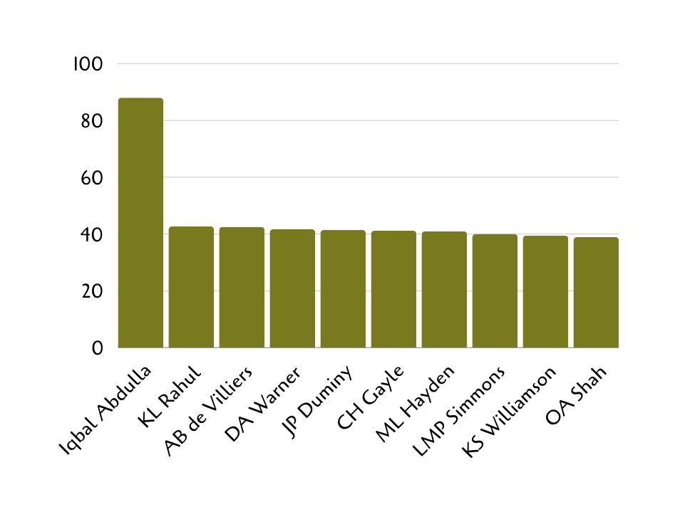
Batters Type 2
Good Average
Table
Chart
Batsman Name | Seasons Played | Total Runs | Dismissals | Batting Average
Iqbal Abdulla | 8 | 88 | 1 | 88.00
KL Rahul | 7 | 2647 | 62 | 42.69
AB de Villiers | 13 | 4849 | 114 | 42.54
DA Warner | 11 | 5254 | 126 | 41.70
JP Duminy | 8 | 2029 | 49 | 41.41
CH Gayle | 12 | 4772 | 116 | 41.14
ML Hayden | 3 | 1107 | 27 | 41.00
LMP Simmons | 4 | 1079 | 27 | 39.96
KS Williamson | 6 | 1619 | 41 | 39.49
OA Shah | 4 | 506 | 13 | 38.92

Slide 8
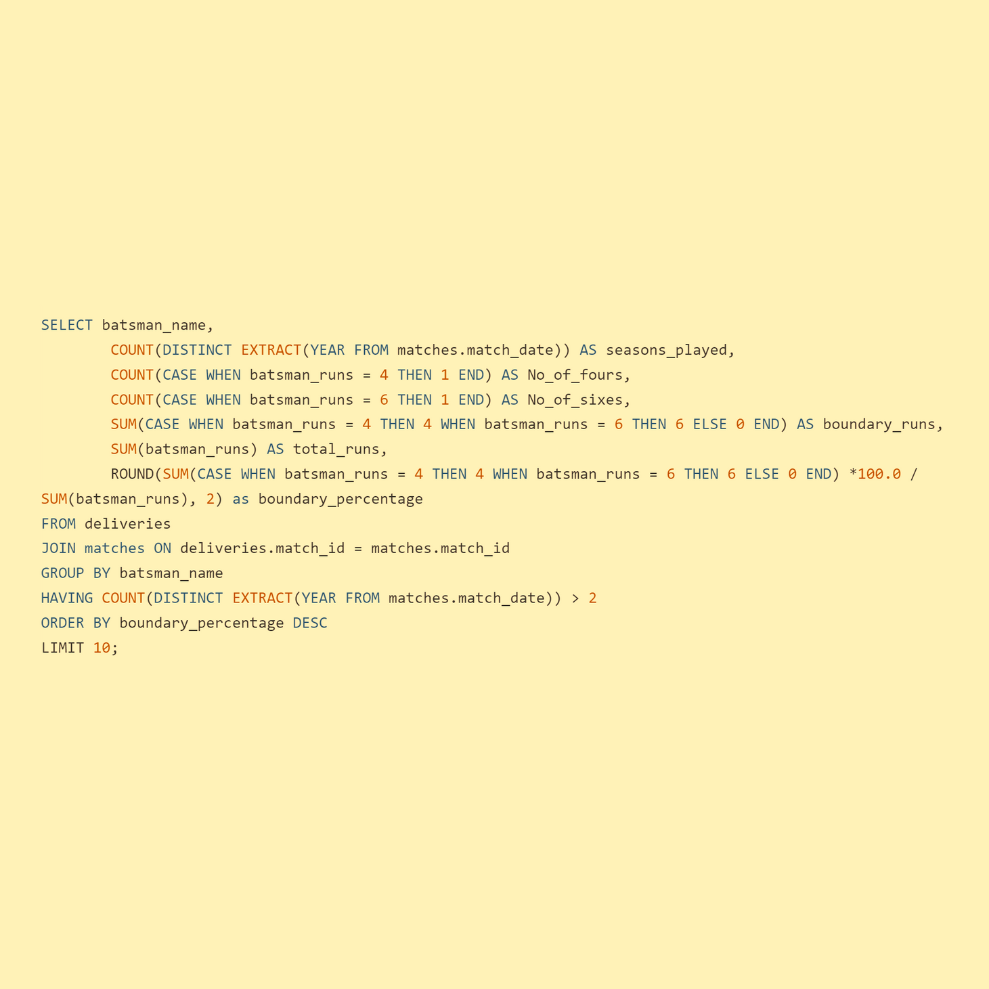
Batters Type 3
Hard Hitting
Task
Query
Now you need to get 2-3 Hard-hitting players who have scored most runs in boundaries and have played more the 2 ipl season. To do that you have to make a list of 10 players you want to bid in the auction so that when you try to grab them in auction you should not pay the amount greater than you have in the purse for a particular player.

Slide 9
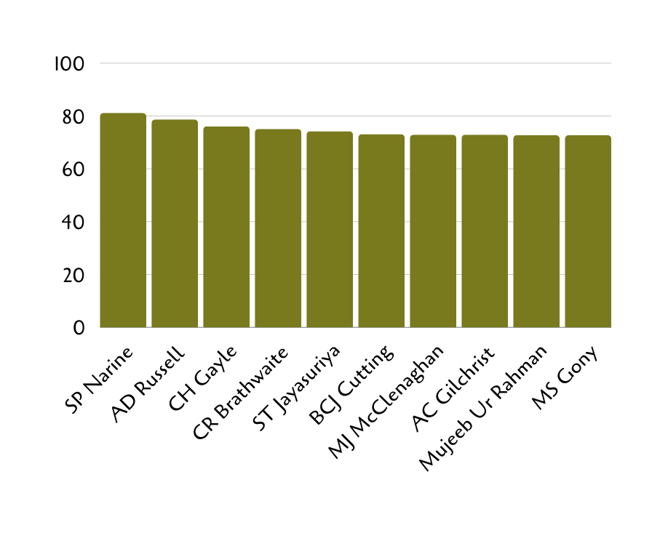
Batters Type 3
Hard Hitting
Table
Chart
Batsman Name | Seasons Played | Boundary Runs | Total Runs | Boundary Percentage
SP Narine | 9 | 724 | 892 | 81.17
AD Russell | 8 | 1194 | 1517 | 78.71
CH Gayle | 12 | 3630 | 4772 | 76.07
CR Brathwaite | 4 | 136 | 181 | 75.14
ST Jayasuriya | 3 | 570 | 768 | 74.22
BCJ Cutting | 5 | 174 | 238 | 73.11
MJ McClenaghan | 5 | 62 | 85 | 72.94
AC Gilchrist | 6 | 1508 | 2069 | 72.89
Mujeeb Ur Rahman | 3 | 8 | 11 | 72.73
MS Gony | 6 | 72 | 99 | 72.73

Slide 10
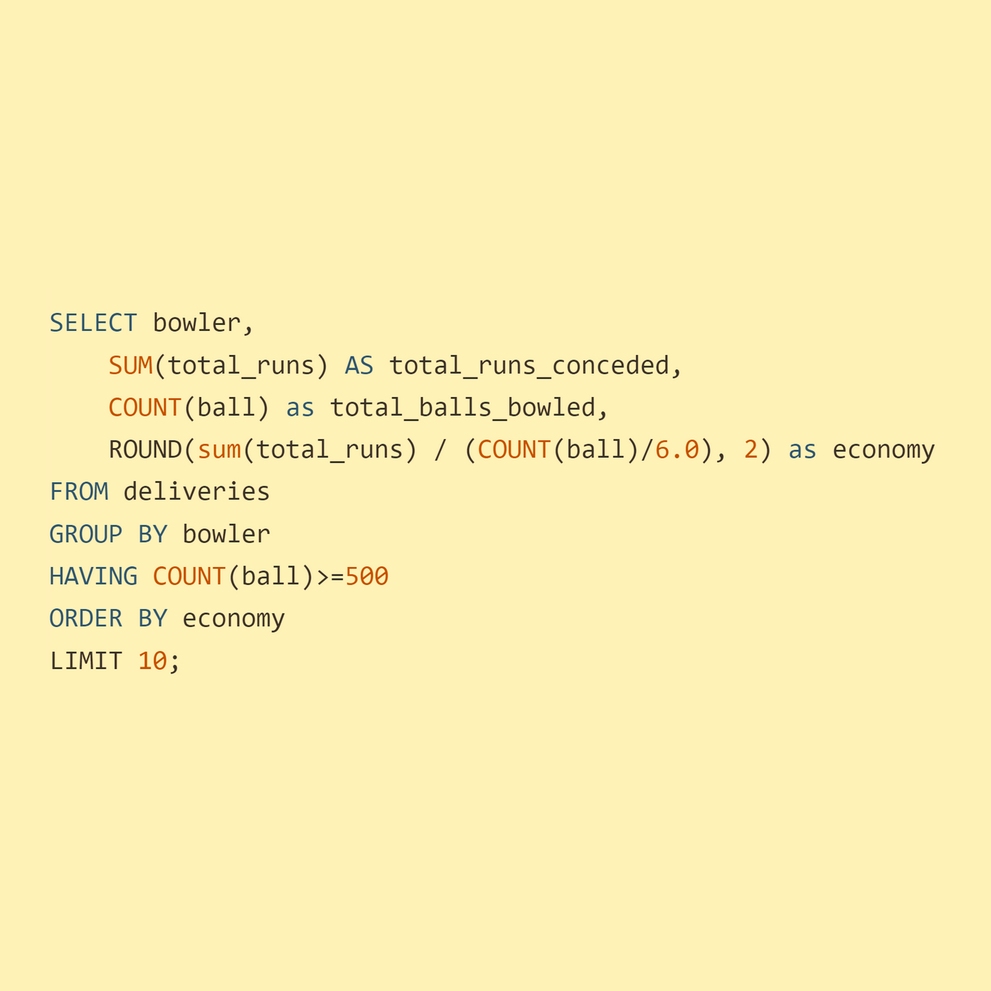
Bowler Type 1
Good Economy
Task
Query
Your first priority is to get 2-3 bowlers with good economy who have bowled at least 500 balls in IPL so far.To do that you have to make a list of 10 players you want to bid in the auction so that when you try to grab them in auction you should not pay the amount greater than you have in the purse for a particular player.

Slide 11
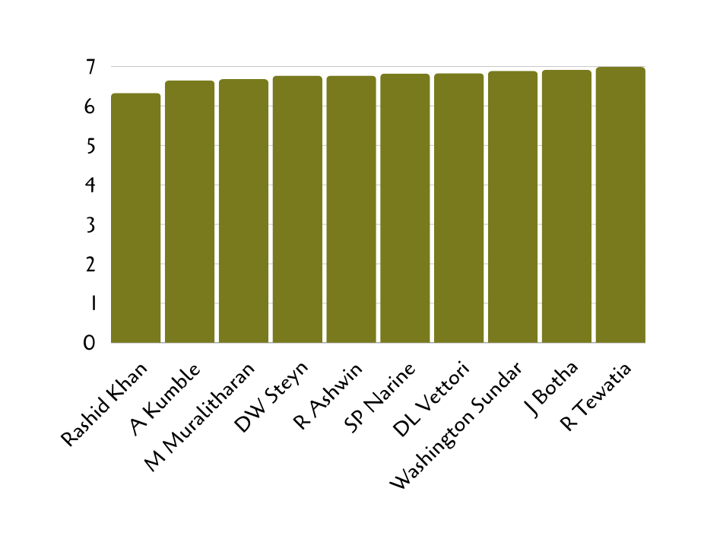
Bowler Type 1
Good Economy
Table
Bowler Name | Total Runs | Total Balls Bowled | Economy
Rashid Khan | 1573 | 1490 | 6.33
A Kumble | 1089 | 983 | 6.65
M Muralitharan | 1755 | 1577 | 6.68
DW Steyn | 2568 | 2276 | 6.77
R Ashwin | 3756 | 3327 | 6.77
SP Narine | 3208 | 2824 | 6.82
DL Vettori | 894 | 785 | 6.83
Washington Sundar | 758 | 660 | 6.89
J Botha | 818 | 709 | 6.92
R Tewatia | 684 | 587 | 6.99
Chart

Slide 12
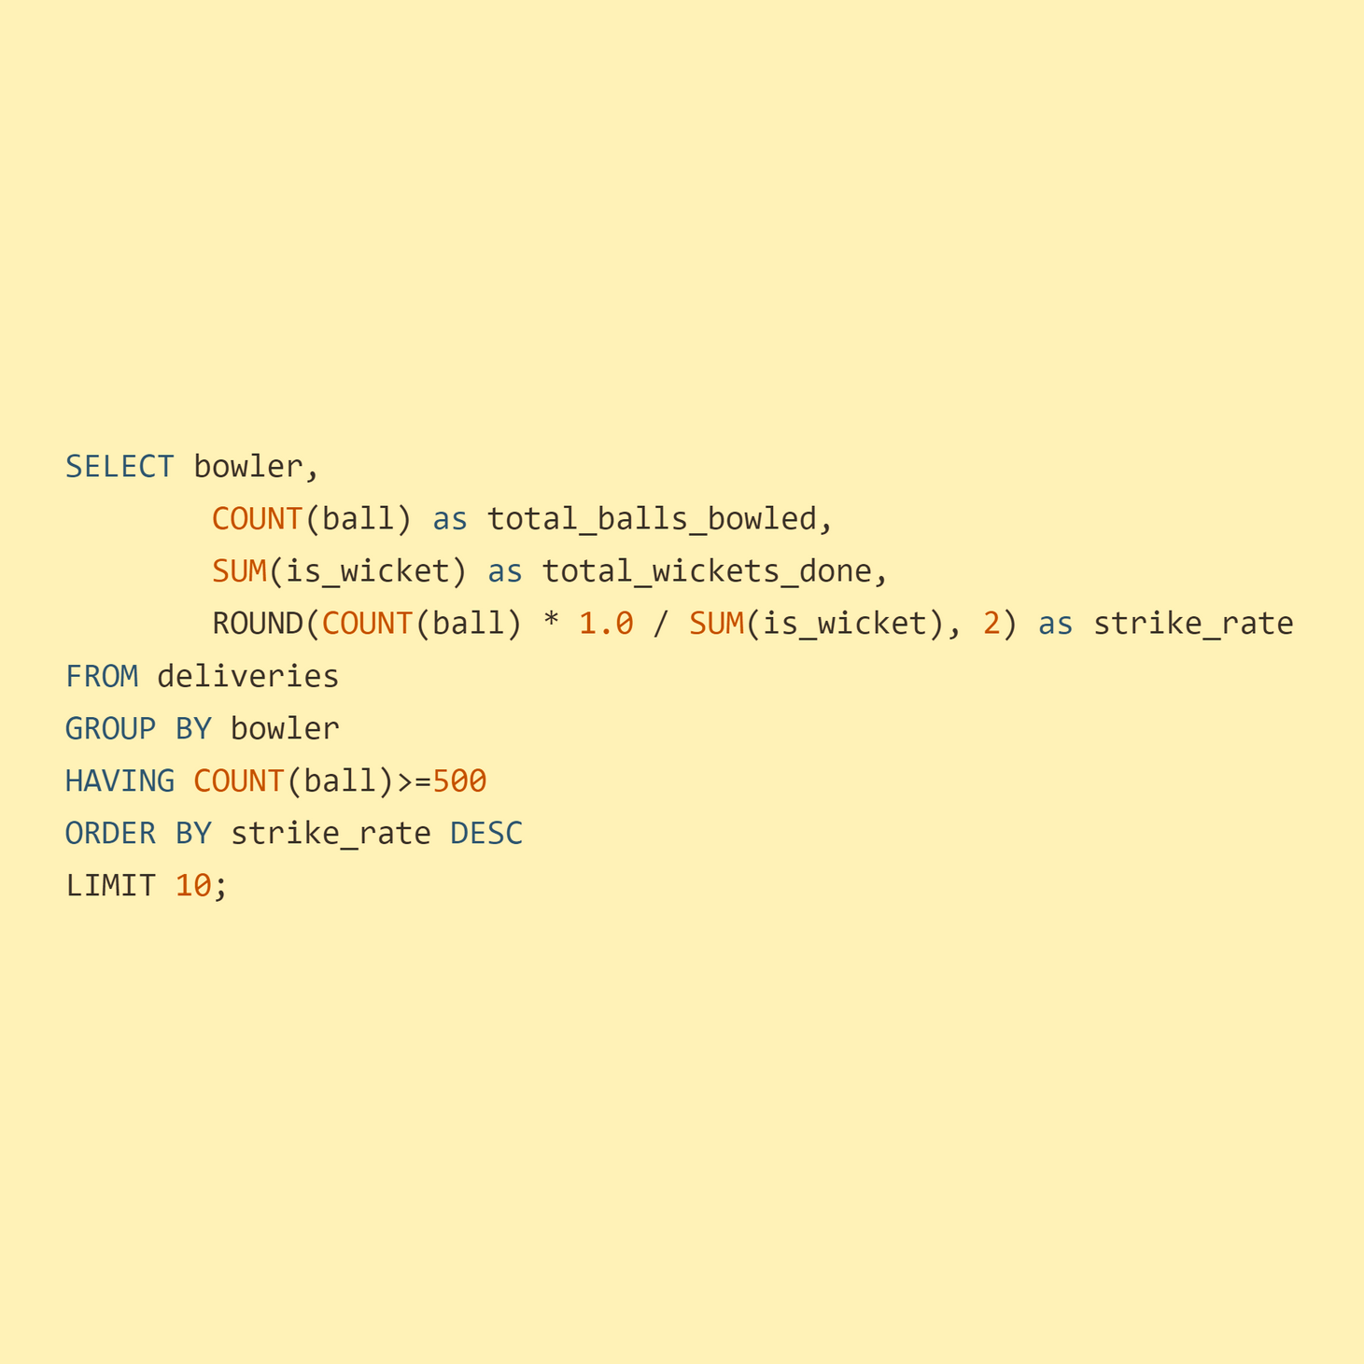
Bowler Type 2
Strike Rate
Task
Query
Now you need to get 2-3 bowlers with the best strike rate and who have bowled at least 500 balls in IPL so far.To do that you have to make a list of 10 players you want to bid in the auction so that when you try to grab them in auction you should not pay the amount greater than you have in the purse for a particular player

Slide 13
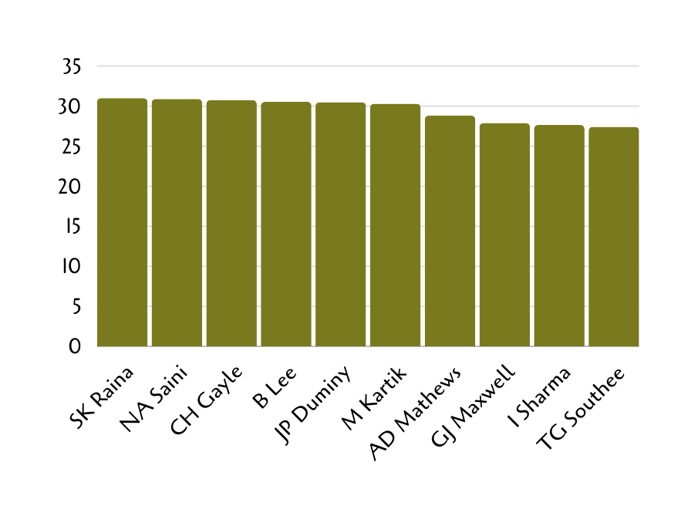
Bowler Type 2
Strike Rate
Table
Chart
Bowler Name | Total Balls Bowled | Total Wickets Done | Strike Rate
SK Raina | 930 | 30 | 31.00
NA Saini | 587 | 19 | 30.89
CH Gayle | 584 | 19 | 30.74
B Lee | 916 | 30 | 30.53
JP Duminy | 701 | 23 | 30.48
M Kartik | 1182 | 39 | 30.31
AD Mathews | 807 | 28 | 28.82
GJ Maxwell | 558 | 20 | 27.90
I Sharma | 2018 | 73 | 27.64
TG Southee | 932 | 34 | 27.41

Slide 14
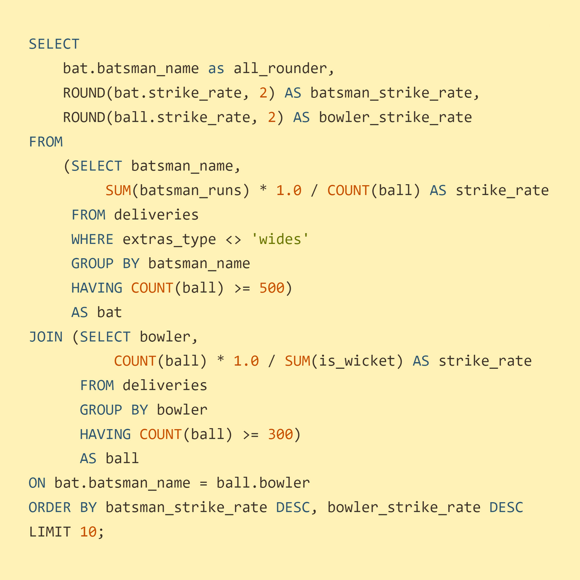
All Rounder
Task
Query
Now you need to get 2-3 All_rounders with the best batting as well as bowling strike rate and who have faced at least 500 balls in IPL so far and have bowled minimum 300 balls.To do that you have to make a list of 10 players you want to bid in the auction so that when you try to grab them in auction you should not pay the amount greater than you have in the purse for a particular player.

Slide 15
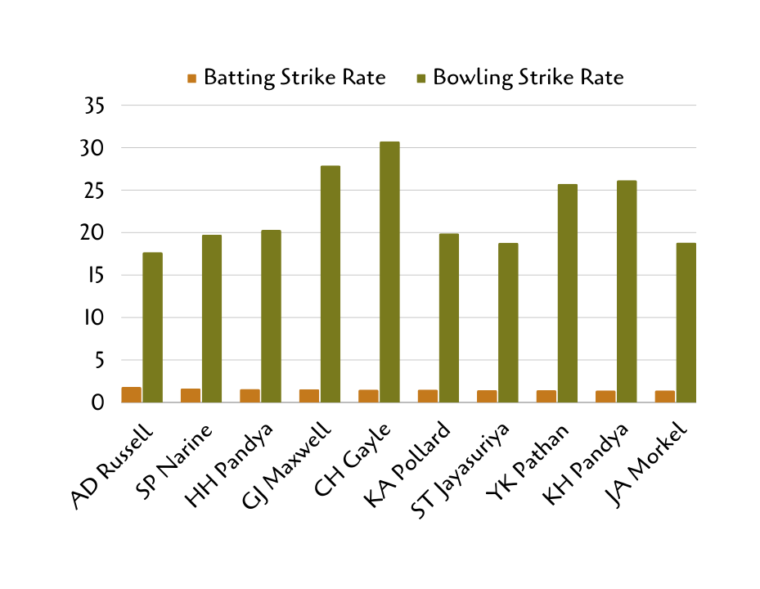
All Rounder
Table
All Rounder | Batsman Strike Rate | Bowler Strike Rate
AD Russell | 1.82 | 17.70
SP Narine | 1.64 | 19.75
HH Pandya | 1.59 | 20.31
GJ Maxwell | 1.55 | 27.90
CH Gayle | 1.50 | 30.74
KA Pollard | 1.50 | 19.92
ST Jayasuriya | 1.44 | 18.81
YK Pathan | 1.43 | 25.74
KH Pandya | 1.42 | 26.18
JA Morkel | 1.42 | 18.82
Chart

Slide 16

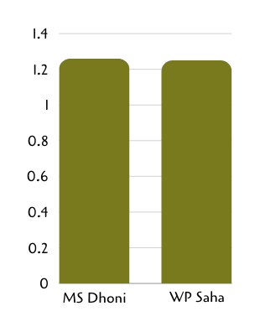
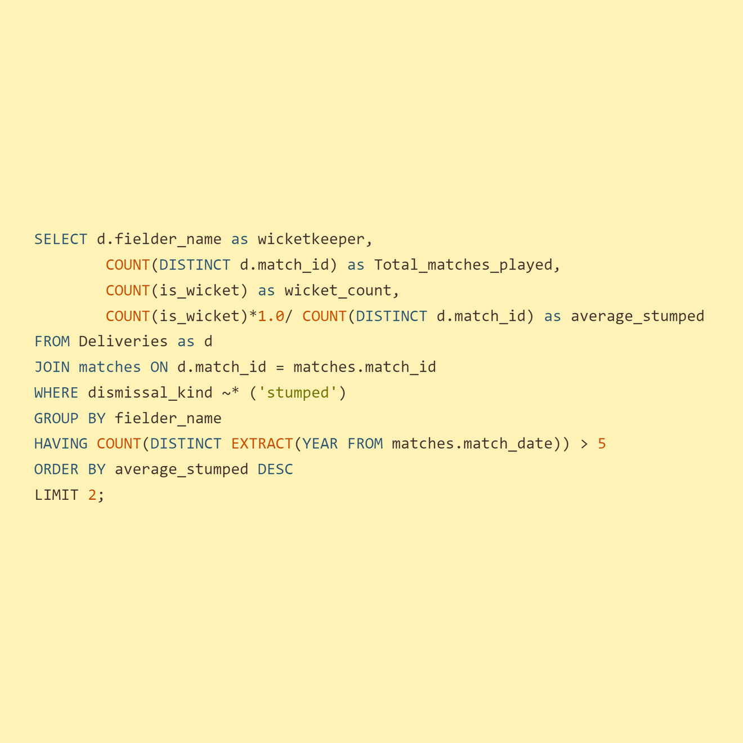
WICKET KEEPER
Chart
Criteria
5+ years experience
Ranked by average stumpings per match.
Query
Table
Wicket Keeper | Total Match Played | Stumped Count | Average Stumps
MS Dhoni | 31 | 39 | 1.26
WP Saha | 16 | 20 | 1.25

Slide 17
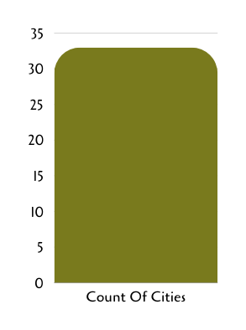
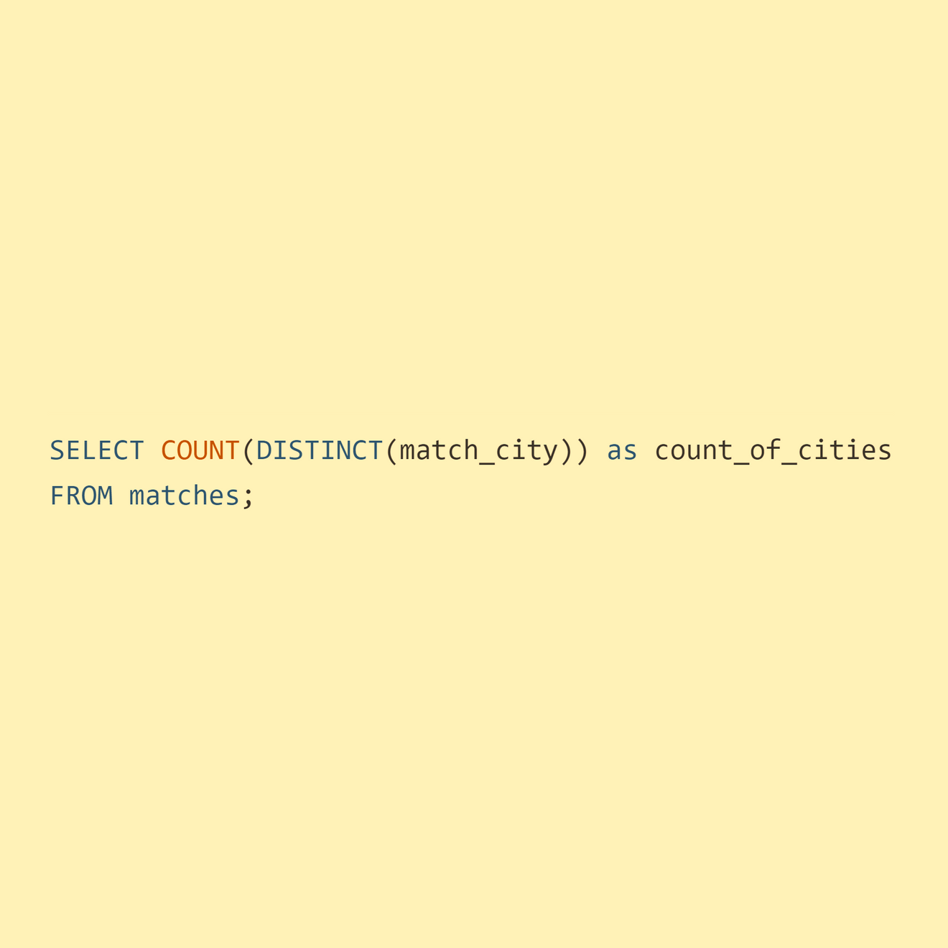
Additional Question 1
Chart
Question 1
Get the count of cities that have hosted an IPL match
Query
Table
Count Of Cities
33

Slide 18
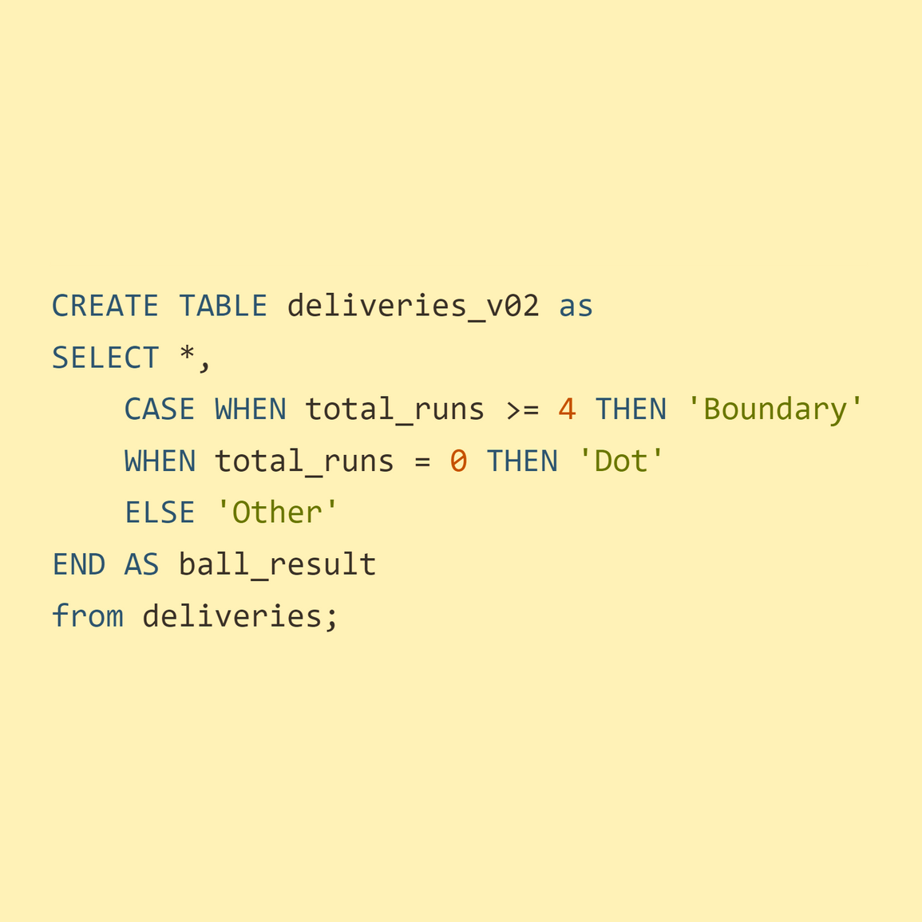
Additional Question 2
Question 2
Create table deliveries_v02 with all the columns of the table ‘deliveries’ and an additional column ball_result containing values boundary, dot or other depending on the total_run (boundary for >= 4, dot for 0 and other for any other number)
Query

Slide 19
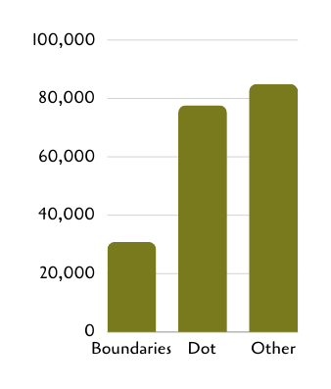
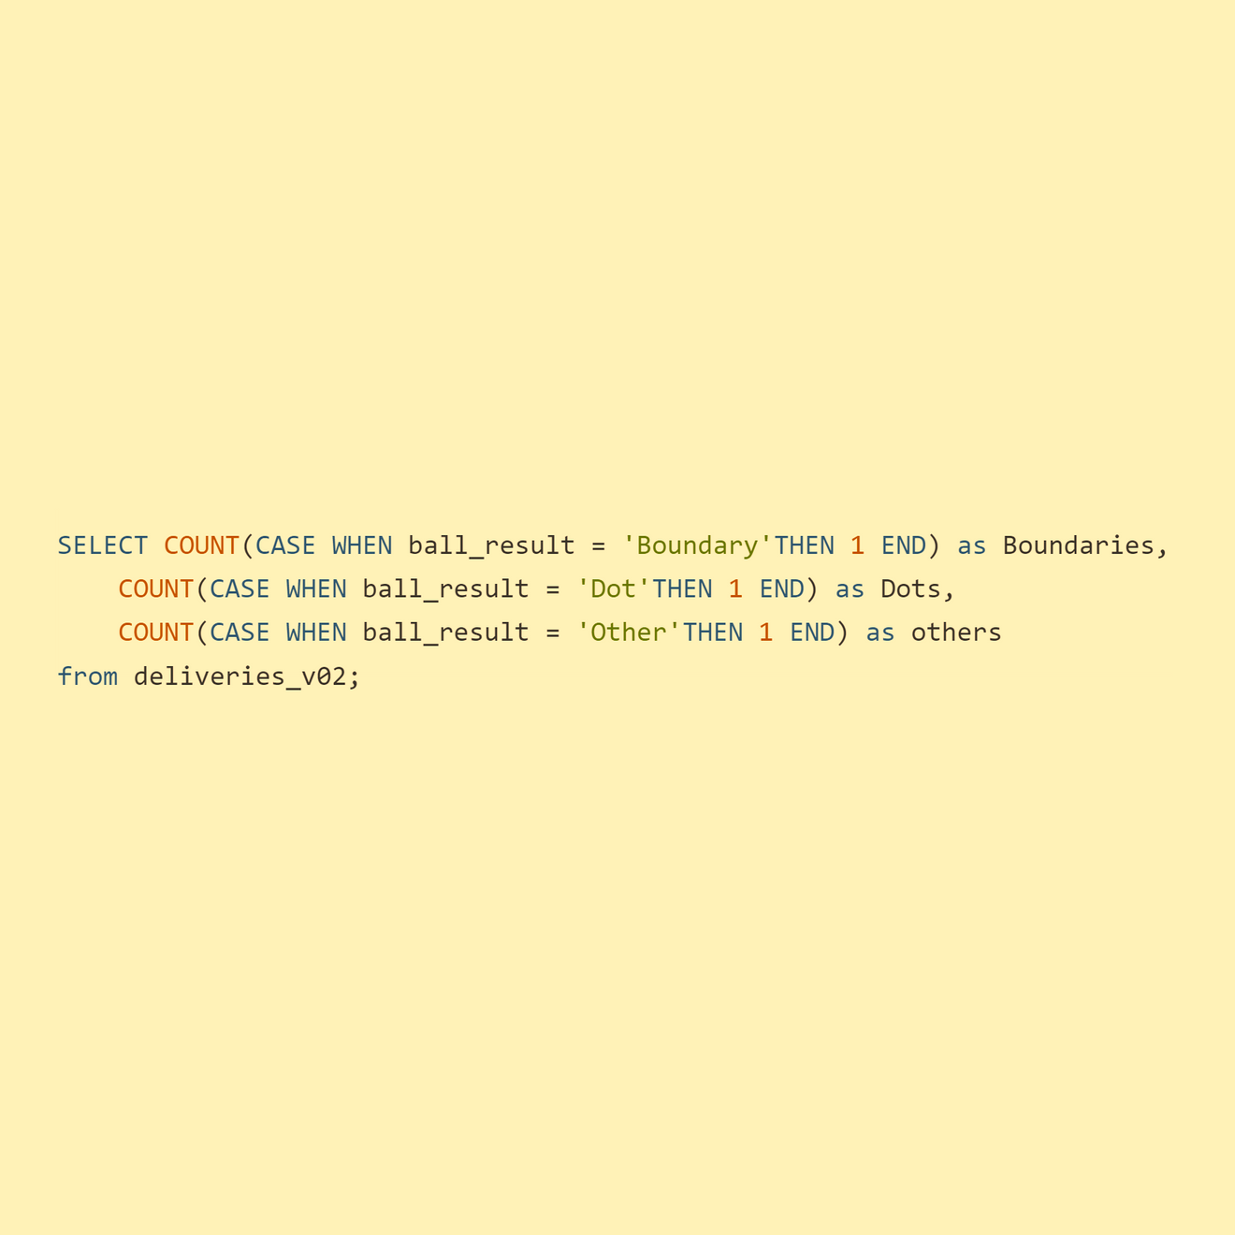
Additional Question 3
Chart
Question 3
Write a query to fetch the total number of boundaries and dot balls from the deliveries_v02 table.
Query
Table
BALL RESULT | COUNT
Boundary | 31468
Dot | 67841
Other | 94159

Slide 20
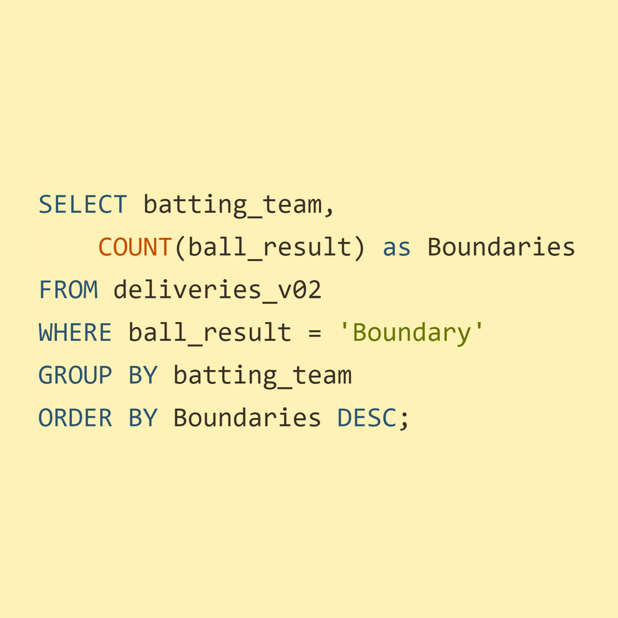
Additional Question 4
Question 4
Query
Write a query to fetch the total number of boundaries scored by each team from the deliveries_v02 table and order it in descending order of the number of boundaries scored

Slide 21
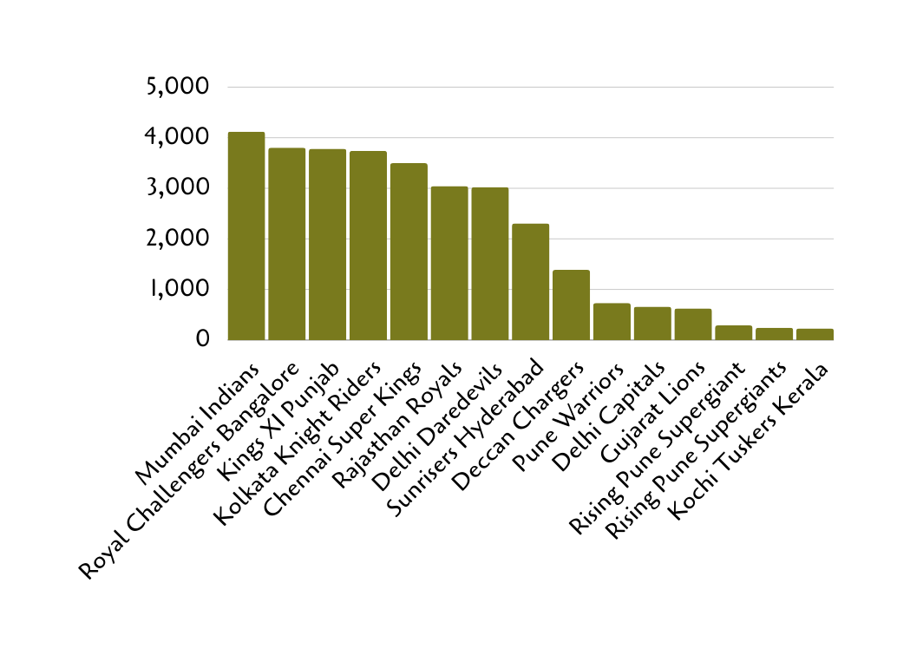
Table
Additional Question 4
TEAMS | BOUNDARIES
Mumbai Indians | 4118
Royal Challengers Bangalore | 3800
Kings XI Punjab | 3780
Kolkata Knight Riders | 3739
Chennai Super Kings | 3496
Rajasthan Royals | 3041
Delhi Daredevils | 3022
Sunrisers Hyderabad | 2306
Deccan Chargers | 1387
Pune Warriors | 733
Delhi Capitals | 659
Gujarat Lions | 624
Rising Pune Supergiant | 290
Rising Pune Supergiants | 242
Kochi Tuskers Kerala | 231
Chart

Slide 22
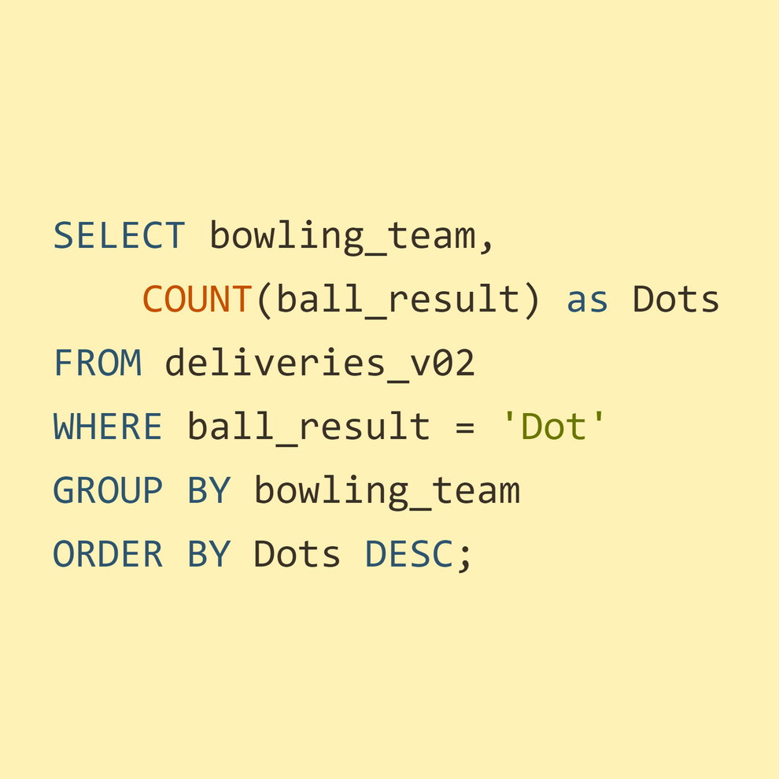
Additional Question 5
Question 5
Query
Write a query to fetch the total number of dot balls bowled by each team and order it in descending order of the total number of dot balls bowled

Slide 23

Table
Additional Question 5
TEAMS | DOTS
Mumbai Indians | 8714
Royal Challengers Bangalore | 7955
Kolkata Knight Riders | 7894
Kings XI Punjab | 7679
Chennai Super Kings | 7593
Rajasthan Royals | 6665
Delhi Daredevils | 6520
Sunrisers Hyderabad | 5248
Deccan Chargers | 3306
Pune Warriors | 1900
Delhi Capitals | 1338
Gujarat Lions | 1095
Rising Pune Supergiant | 698
Kochi Tuskers Kerala | 626
Rising Pune Supergiants | 539
NA | 71
Chart

Slide 24
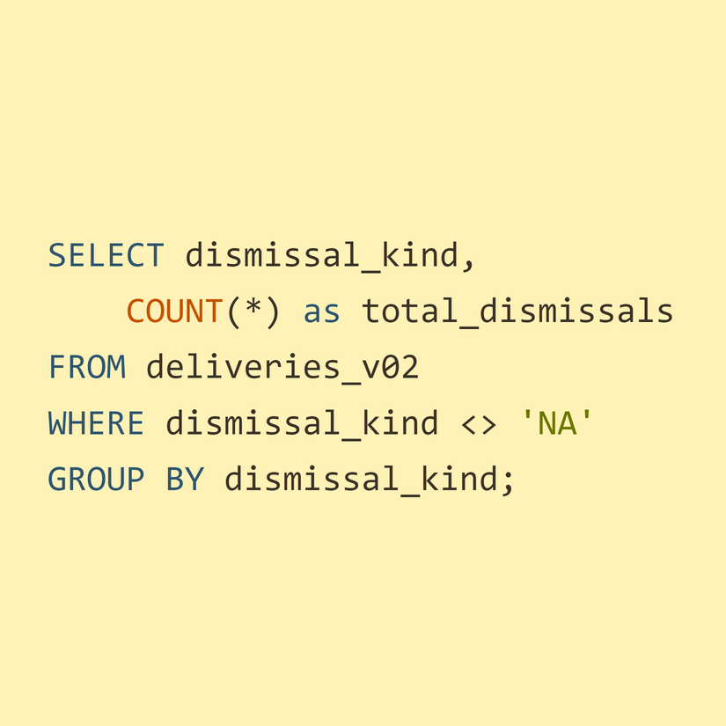
Additional Question 6
Question 6
Query
Write a query to fetch the total number of dismissals by dismissal kinds where dismissal kind is not NA

Slide 25
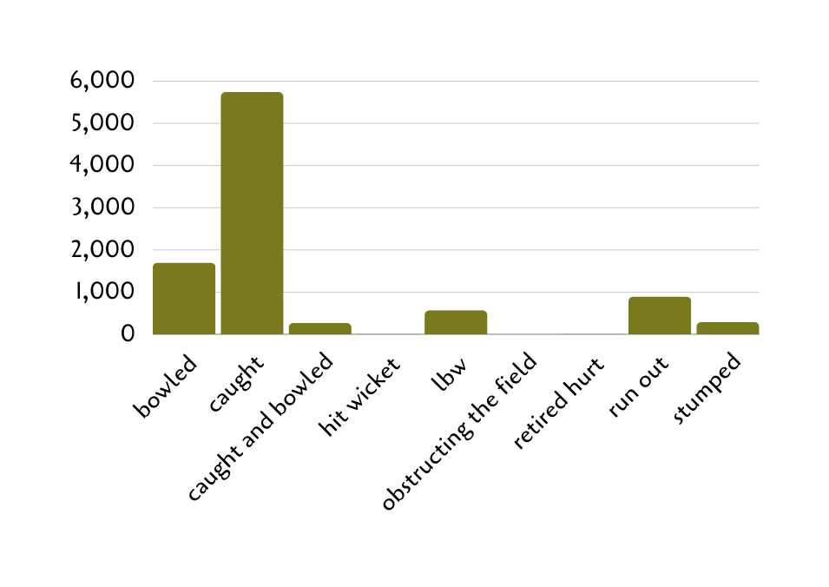
Additional Question 6
Table
Dismissal Kind | Count
Bowled | 1700
Caught | 5743
Caught and Bowled | 269
Hit Wicket | 12
LBW | 571
Obstructing the field | 2
Retired hurt | 11
Run out | 893
Stumped | 294
Chart

Slide 26
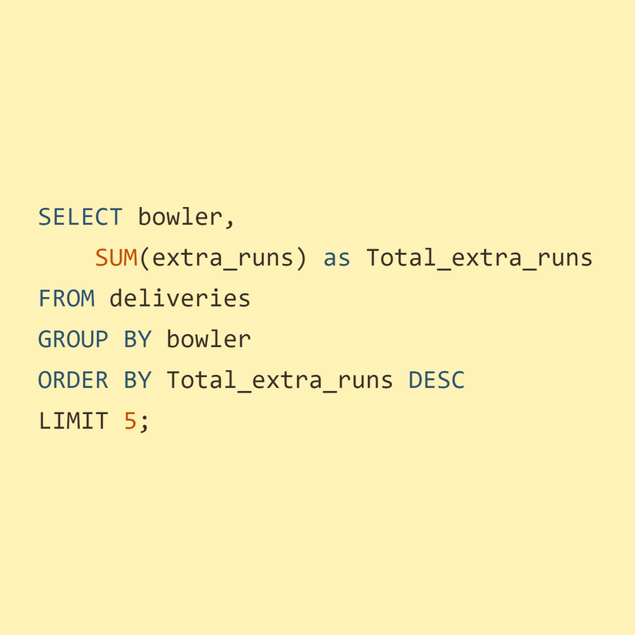
Additional Question 7
Question 7
Query
Write a query to get the top 5 bowlers who conceded maximum extra runs from the deliveries table

Slide 27
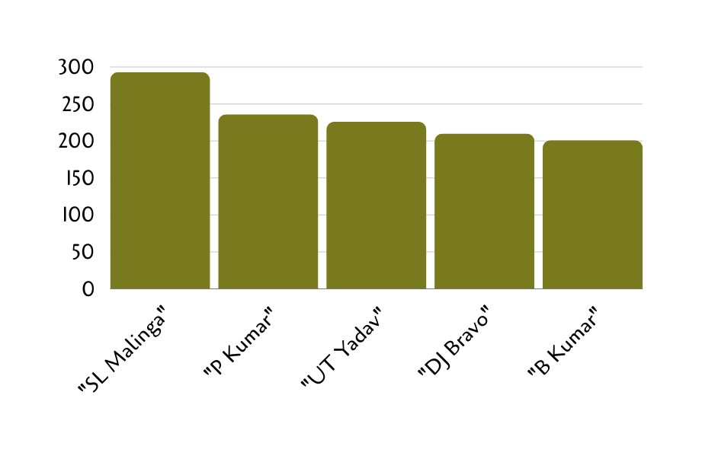
Additional Question 7
Table
Chart
Bowler | Total Extra Runs
SL Malinga | 293
P Kumar | 236
UT Yadav | 226
DJ Bravo | 210
B Kumar | 201

Slide 28
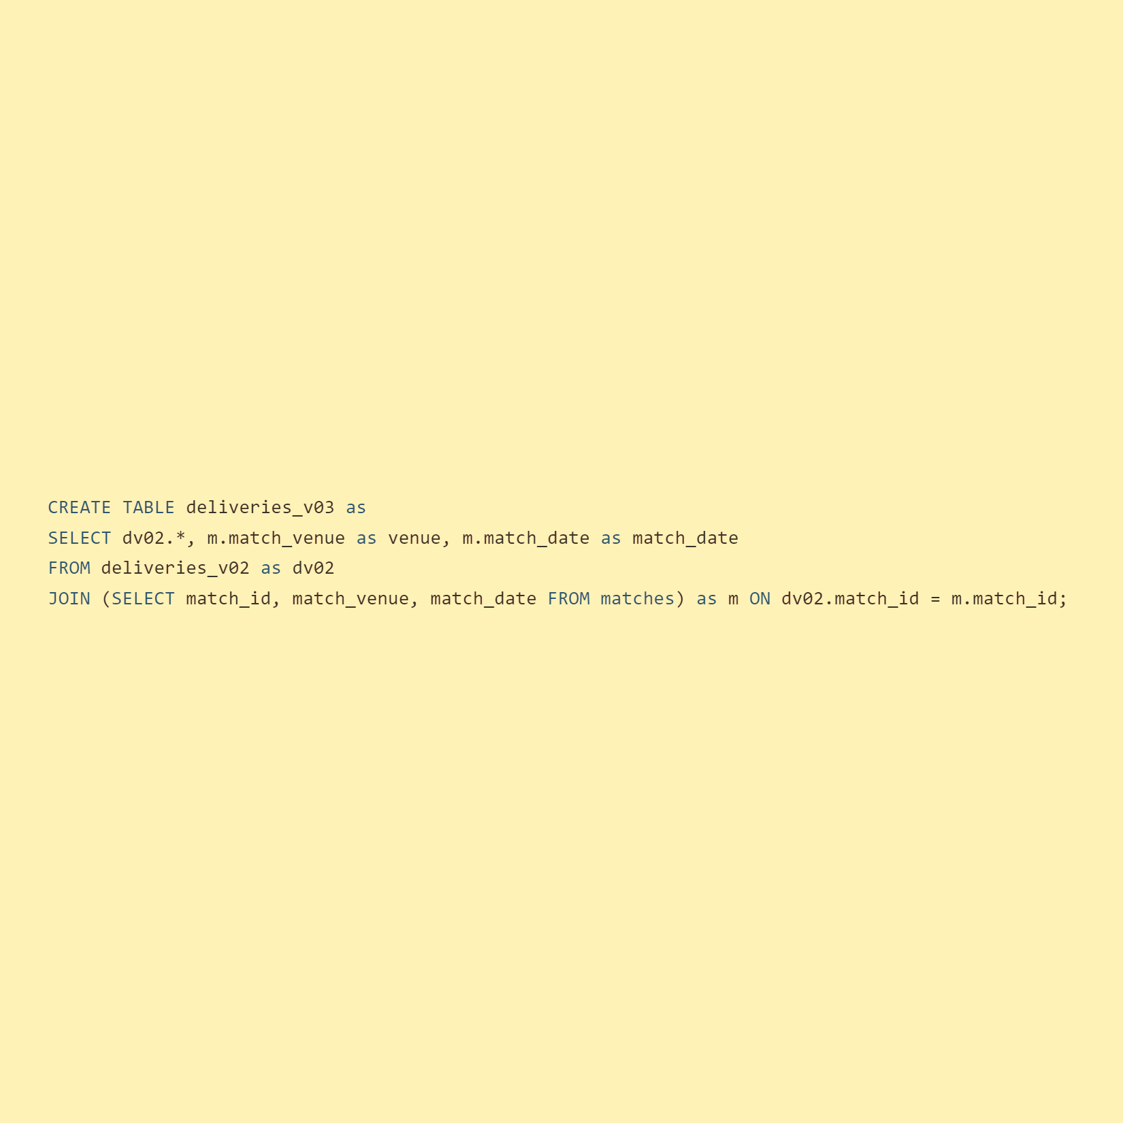
Additional Question 8
Question 8
Write a query to create a table named deliveries_v03 with all the columns of deliveries_v02 table and two additional column (named venue and match_date) of venue and date from table matches
Query

Slide 29
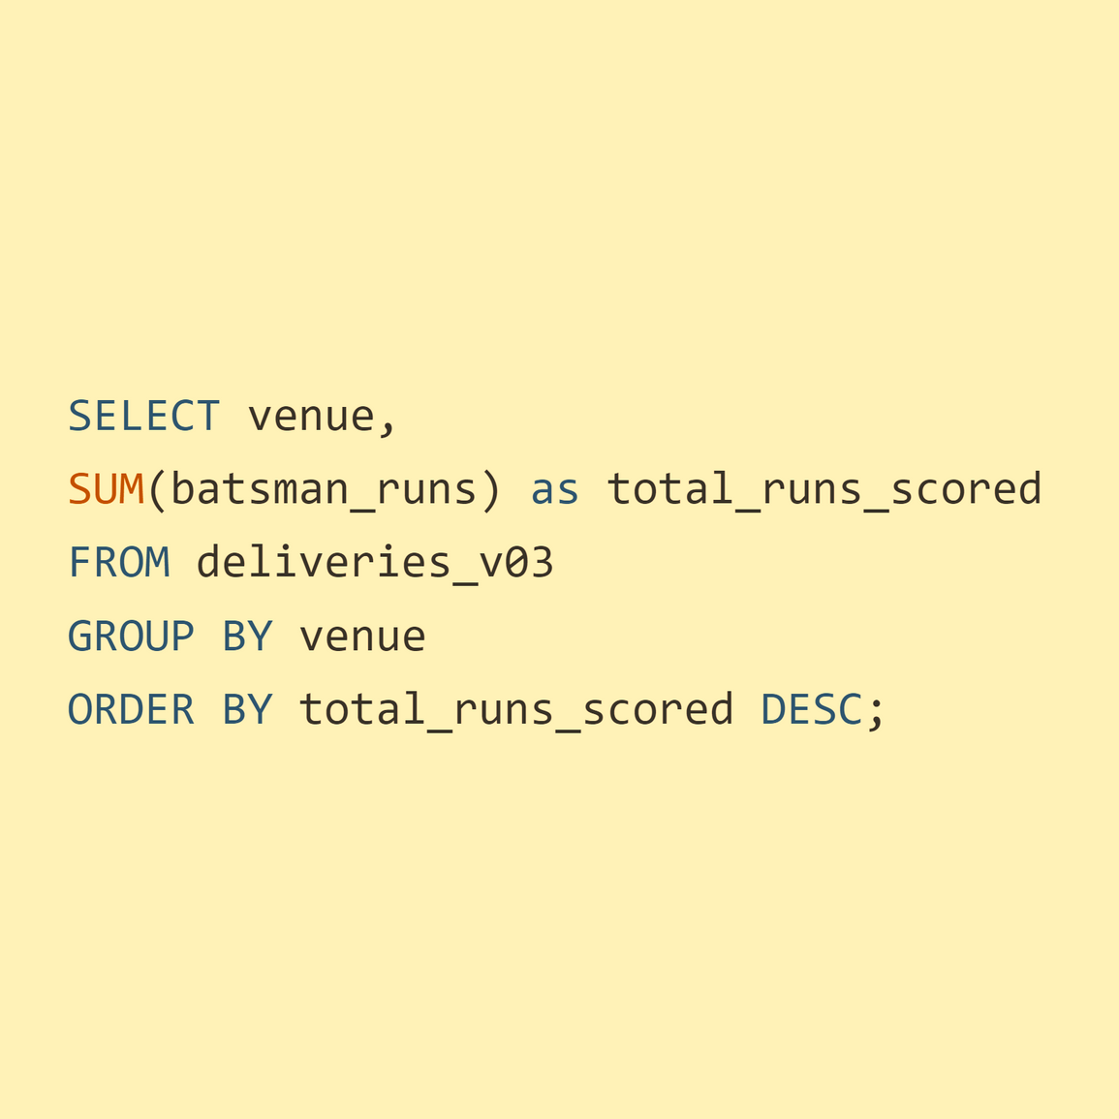
Additional Question 9
Question 9
Query
Write a query to fetch the total runs scored for each venue and order it in the descending order of total runs scored.

Slide 30
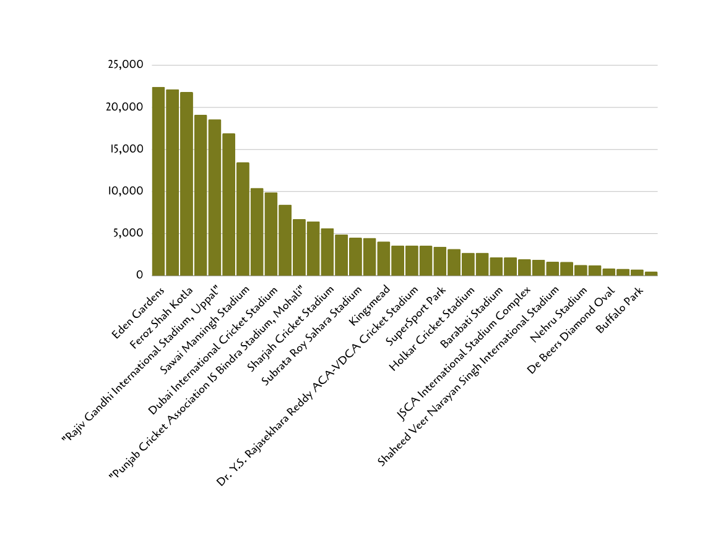
Table
Additional Question 9
Bowler | Total Extra Runs
Eden Gardens | 22443
Wankhede Stadium | 22158
Feroz Shah Kotla | 21833
M Chinnaswamy Stadium | 19113
Rajiv Gandhi International Stadium, Uppal | 18584
MA Chidambaram Stadium, Chepauk | 16916
Sawai Mansingh Stadium | 13473
Punjab Cricket Association Stadium, Mohali | 10421
Dubai International Cricket Stadium | 9910
Sheikh Zayed Stadium | 8443
Punjab Cricket Association IS Bindra Stadium, Mohali | 6750
Maharashtra Cricket Association Stadium | 6465
Sharjah Cricket Stadium | 5637
M.Chinnaswamy Stadium | 4896
Subrata Roy Sahara Stadium | 4518
Dr DY Patil Sports Academy | 4490
Kingsmead | 4076
Brabourne Stadium | 3596
Dr. Y.S. Rajasekhara Reddy ACA-VDCA Cricket Stadium | 3585
Sardar Patel Stadium, Motera | 3571
SuperSport Park | 3440
Saurashtra Cricket Association Stadium | 3185
Holkar Cricket Stadium | 2735
Himachal Pradesh Cricket Association Stadium | 2720
Barabati Stadium | 2195
New Wanderers Stadium | 2184
JSCA International Stadium Complex | 1956
St George's Park | 1904
Shaheed Veer Narayan Singh International Stadium | 1664
Newlands | 1652
Nehru Stadium | 1286
Green Park | 1236
De Beers Diamond Oval | 858
Vidarbha Cricket Association Stadium, Jamtha | 822
Buffalo Park | 742
OUTsurance Oval | 488
Chart

Slide 31
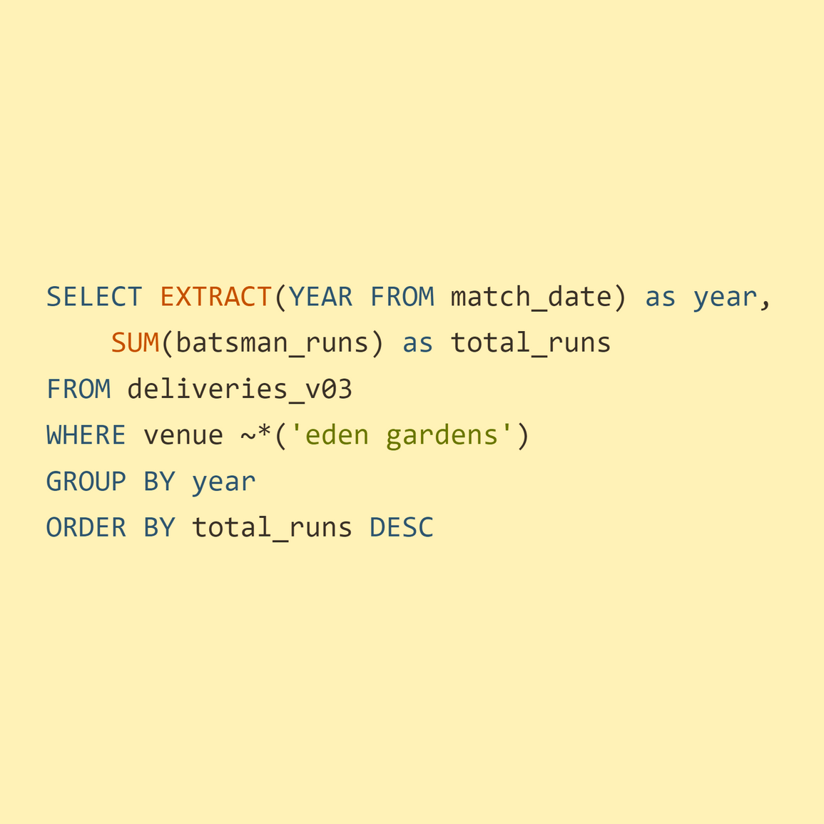
Additional Question 10
Question 10
Query
Write a query to fetch the year-wise total runs scored at Eden Gardens and order it in the descending order of total runs scored

Slide 32
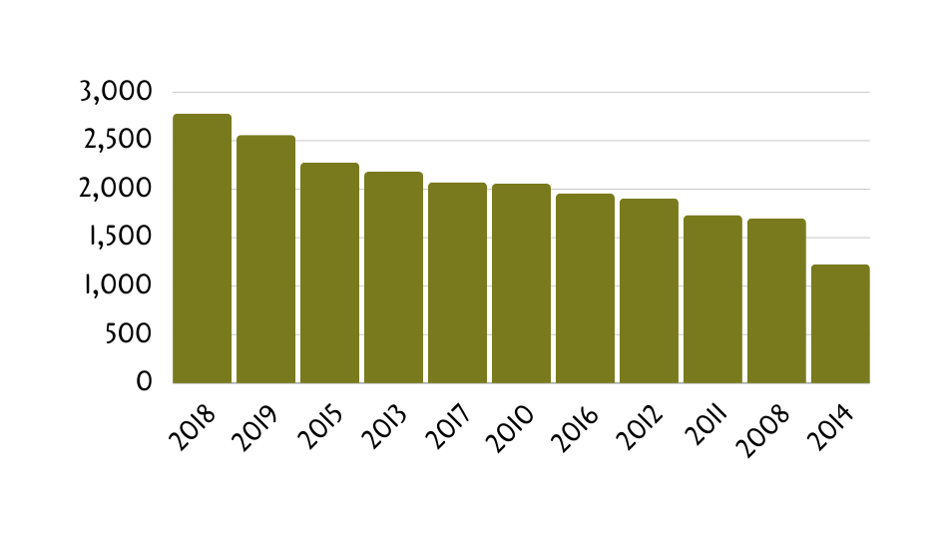
Additional Question 10
Table
Chart
YEAR | TOTAL RUNS
2018 | 2779
2019 | 2559
2015 | 2276
2013 | 2181
2017 | 2071
2010 | 2058
2016 | 1956
2012 | 1906
2011 | 1732
2008 | 1698
2014 | 1227

Slide 33

Thank
You

